Slide 1
Astro 331
Attitude Determination & Control Subsystem (ADCS)
Supp Crs Mtl & SMAD Ch 11.1

Slide 2
Lesson Objectives
Explain attitude determination and control subsystem functions
List and describe typical attitude determination and control performance requirements
Describe common spacecraft attitude control methods and approximately how accurately they can control the vehicle’s pointing
Calculate spacecraft external disturbance torques
List and describe spacecraft internal disturbance torques
List and describe common spacecraft attitude sensors and actuators
Size thrusters or wheels to perform attitude control actuator functions

Slide 3
ADCS Functions
Stabilizes vehicle and orients it in desired directions during mission despite internal and external disturbance torques
Stabilize S/C
Point S/C in desired orientation (called “attitude”)
determine S/C attitude (sensors)
control S/C attitude (actuators)
must overcome internal and external disturbance torques

Slide 4
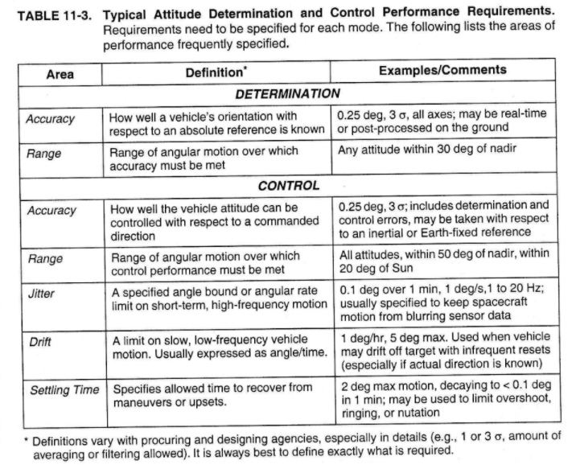

Slide 5
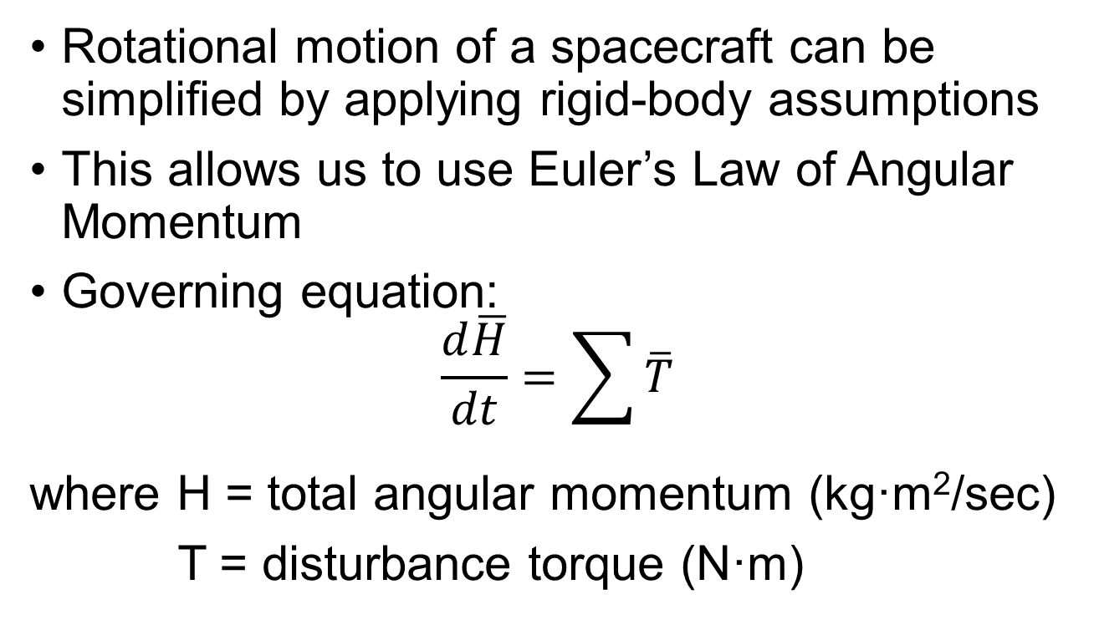
Attitude Dynamics Fundamentals
Rotational motion of a spacecraft can be simplified by applying rigid-body assumptions
This allows us to use Euler’s Law of Angular Momentum
Governing equation:
$$\frac{d\overline{H}}{dt}=\sum{\overline{T}}$$
where H = total angular momentum (kg·m²/sec)
T = disturbance torque (N·m)

Slide 6
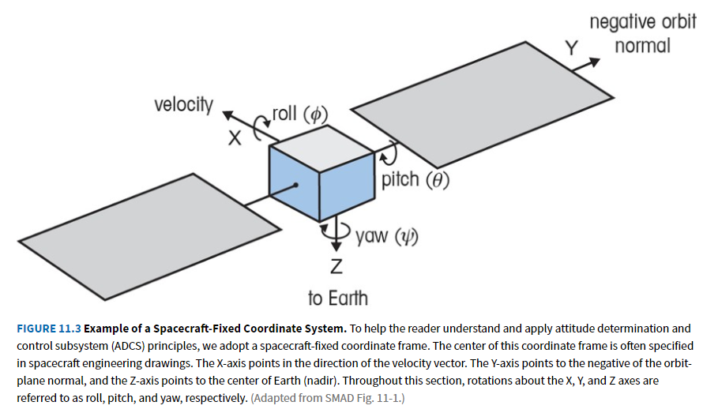

Slide 7
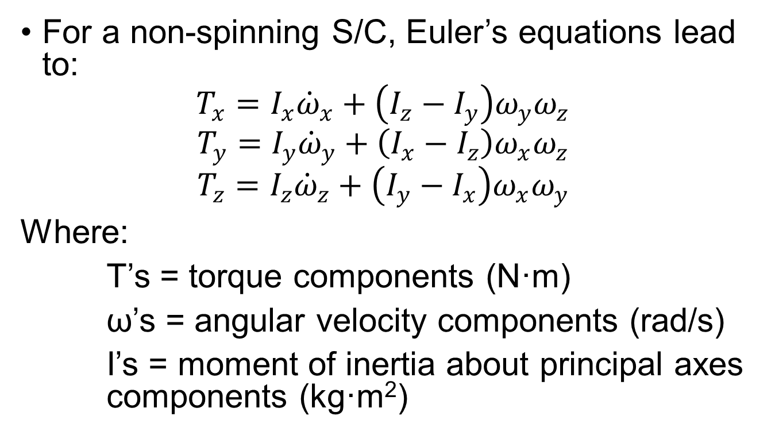
Attitude Dynamics Fundamentals (Continued)
For a non-spinning S/C, Euler’s equations lead to:
$$T_{x}=I_{x}{\dot{ω}}_{x}+\left(I_{z}−I_{y}\right)ω_{y}ω_{z}$$
$$T_{y}=I_{y}{\dot{ω}}_{y}+\left(I_{x}−I_{z}\right)ω_{x}ω_{z}$$
$$T_{z}=I_{z}{\dot{ω}}_{z}+\left(I_{y}−I_{x}\right)ω_{x}ω_{y}$$
Where:
T’s = torque components (N·m)
ω’s = angular velocity components (rad/s)
I’s = moment of inertia about principal axes components (kg·m²)

Slide 8
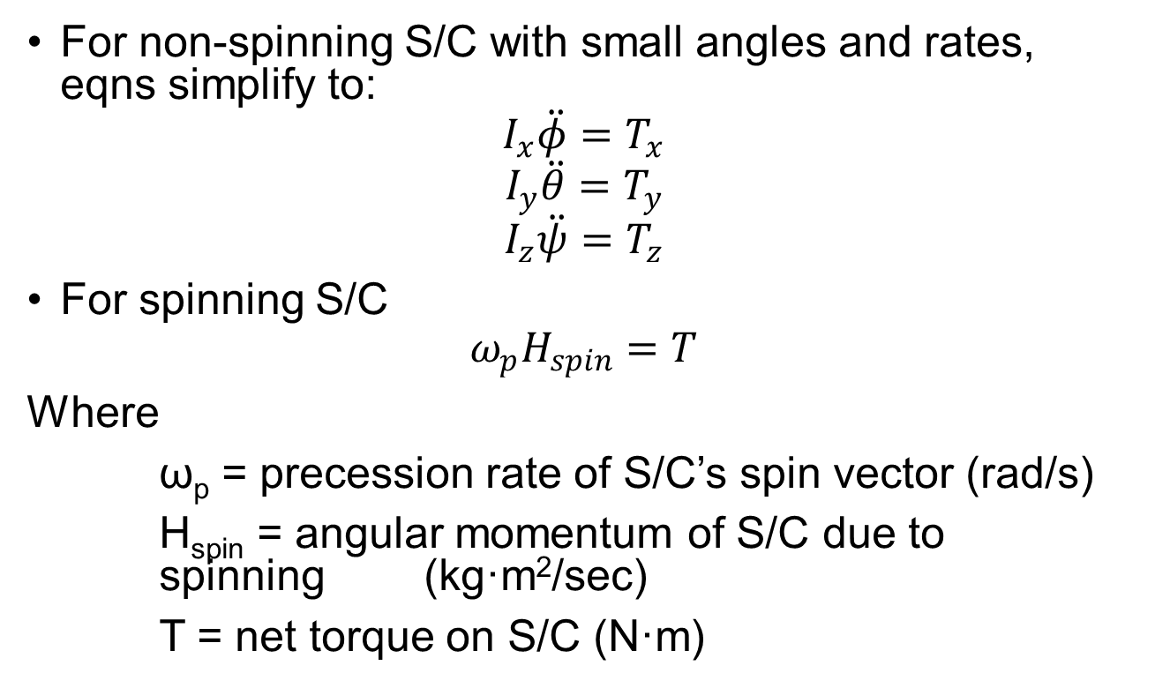
Attitude Dynamics Fundamentals (Continued)
For non-spinning S/C with small angles and rates, eqns simplify to:
$$I_{x}\ddot{φ}=T_{x}$$
$$I_{y}\ddot{θ}=T_{y}$$
$$I_{z}\ddot{ψ}=T_{z}$$
For spinning S/C
$$ω_{p}H_{spin}=T$$
Where
ω_{p} = precession rate of S/C’s spin vector (rad/s)
H_{spin} = angular momentum of S/C due to spinning (kg·m²/sec)
T = net torque on S/C (N·m)

Slide 9
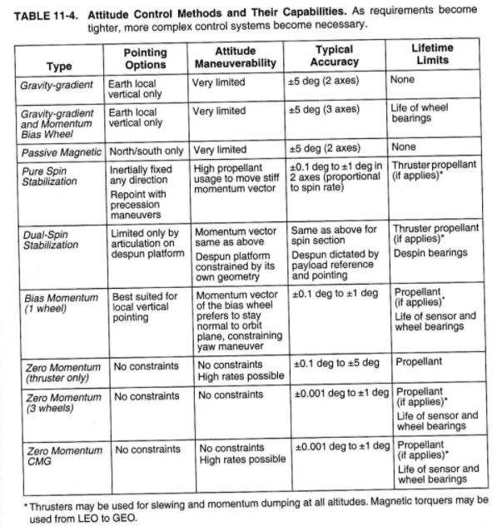

Slide 10
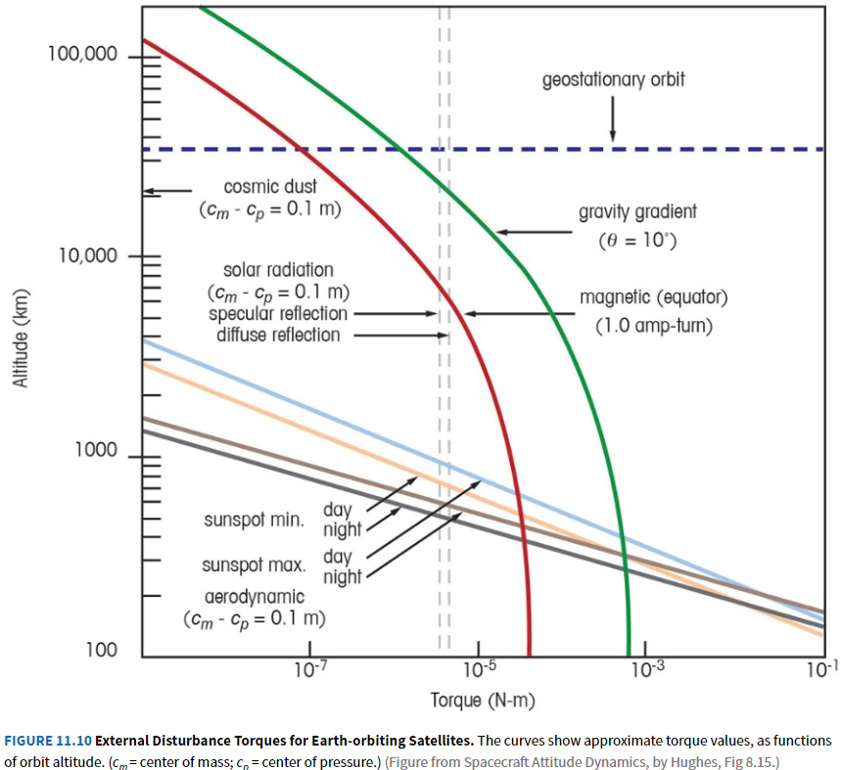
External Disturbance Torques
Designing Space Missions and Systems, Figure 11.10

Slide 11
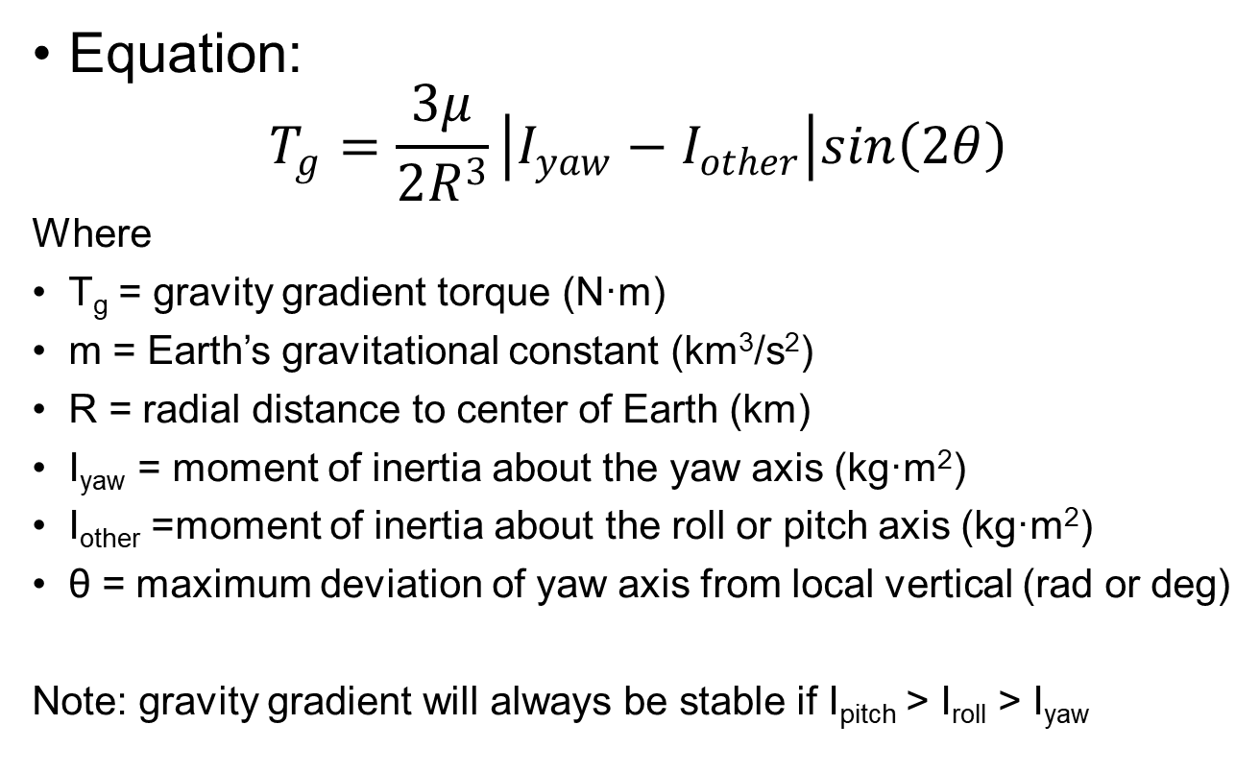
Gravity Gradient
Equation:
$$T_{g}=\frac{3μ}{2R^{3}}\left|I_{yaw}−I_{other}\right|sin\left(2θ\right)$$
Where
T_{g} = gravity gradient torque (N·m)
m = Earth’s gravitational constant (km³/s²)
R = radial distance to center of Earth (km)
I_{yaw} = moment of inertia about the yaw axis (kg·m²)
I_{other} =moment of inertia about the roll or pitch axis (kg·m²)
θ = maximum deviation of yaw axis from local vertical (rad or deg)
Note: gravity gradient will always be stable if I_{pitch} > I_{roll} > I_{yaw}

Slide 12
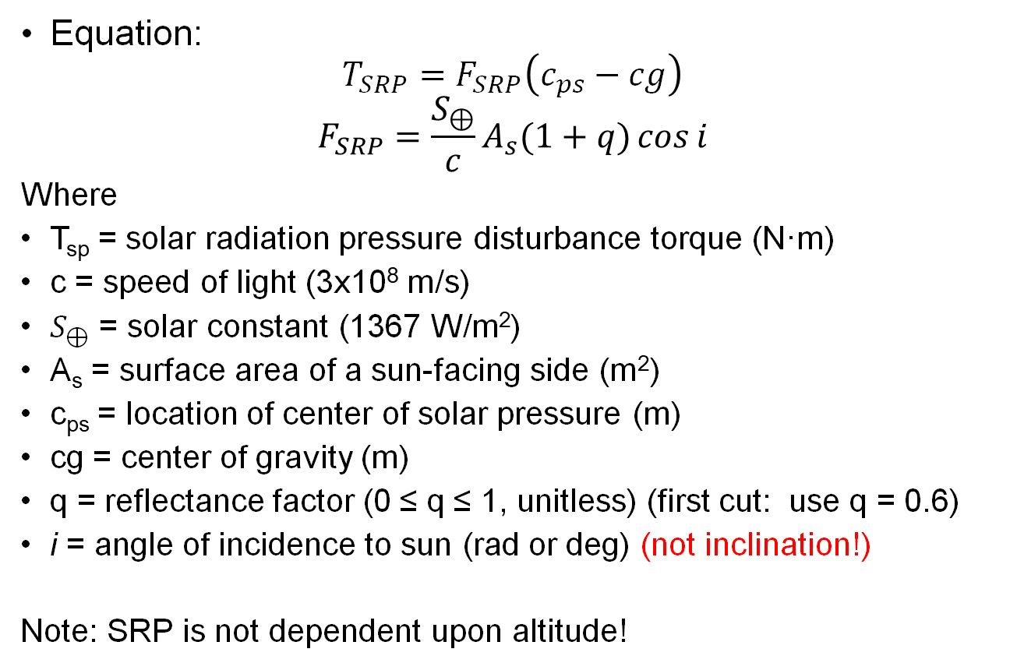
Solar Radiation Pressure (SRP)
Equation:
$$T_{SRP}=F_{SRP}\left(c_{ps}−cg\right)$$
$$F_{SRP}=\frac{S_{⊕}}{c}A_{s}(1+q)\cos{i}$$
Where
T_{sp} = solar radiation pressure disturbance torque (N·m)
c = speed of light (3x10⁸ m/s)
$S_{⊕}$ = solar constant (1367 W/m²)
A_{s} = surface area of a sun-facing side (m²)
c_{ps} = location of center of solar pressure (m)
cg = center of gravity (m)
q = reflectance factor (0 ≤ q ≤ 1, unitless) (first cut: use q = 0.6)
i = angle of incidence to sun (rad or deg) (not inclination!)
Note: SRP is not dependent upon altitude!

Slide 13
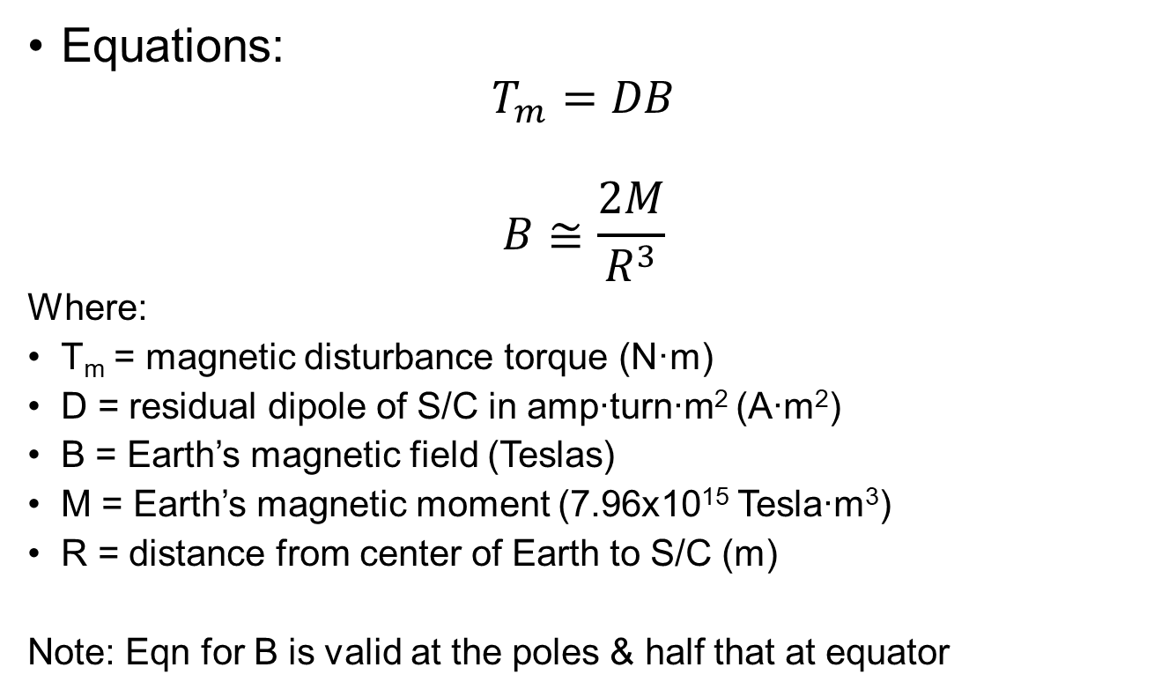
Magnetic Disturbance Torques
Equations:
$$T_{m}=DB$$
$$B≅\frac{2M}{R^{3}}$$
Where:
T_{m} = magnetic disturbance torque (N·m)
D = residual dipole of S/C in amp∙turn∙m² (A∙m²)
B = Earth’s magnetic field (Teslas)
M = Earth’s magnetic moment (7.96x10¹⁵ Tesla∙m³)
R = distance from center of Earth to S/C (m)
Note: Eqn for B is valid at the poles & half that at equator

Slide 14
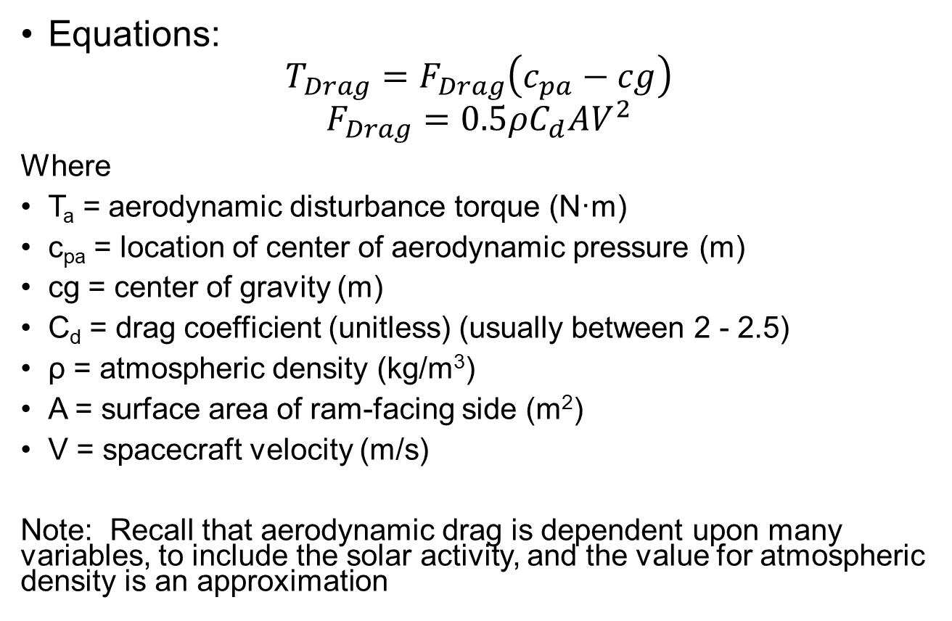
Aerodynamic Drag
Equations:
$$T_{Drag}=F_{Drag}\left(c_{pa}−cg\right)$$
$$F_{Drag}=0.5ρC_{d}AV^{2}$$
Where
T_{a} = aerodynamic disturbance torque (N·m)
c_{pa} = location of center of aerodynamic pressure (m)
cg = center of gravity (m)
C_{d} = drag coefficient (unitless) (usually between 2 - 2.5)
ρ = atmospheric density (kg/m³)
A = surface area of ram-facing side (m²)
V = spacecraft velocity (m/s)
Note: Recall that aerodynamic drag is dependent upon many variables, to include the solar activity, and the value for atmospheric density is an approximation

Slide 15
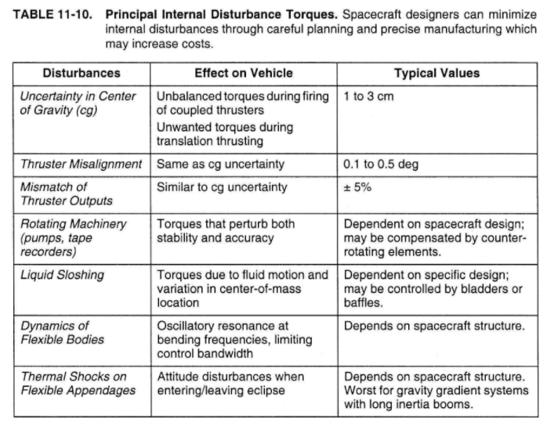

Slide 16
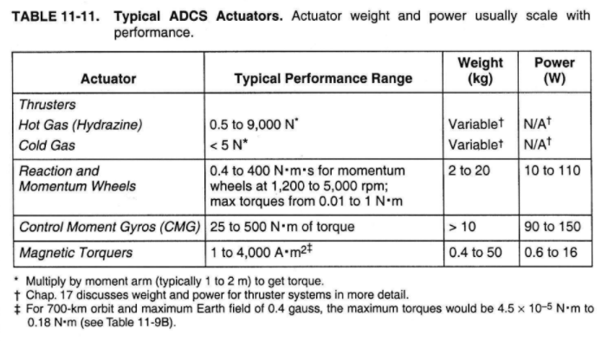

Slide 17
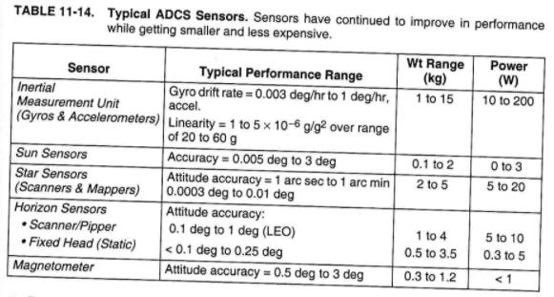

Slide 18
Calculate Wheel/Thruster Size
Control authority: torque capability of actuators
Goal: want control authority to be greater than disturbance torques
For any single axis, disturbance torque may have cyclic terms (that integrate to zero over an integral # of cycles) and secular terms (not periodic)
Wheels can be sized counteract cyclic torques terms but will eventually saturate from secular terms

Slide 19
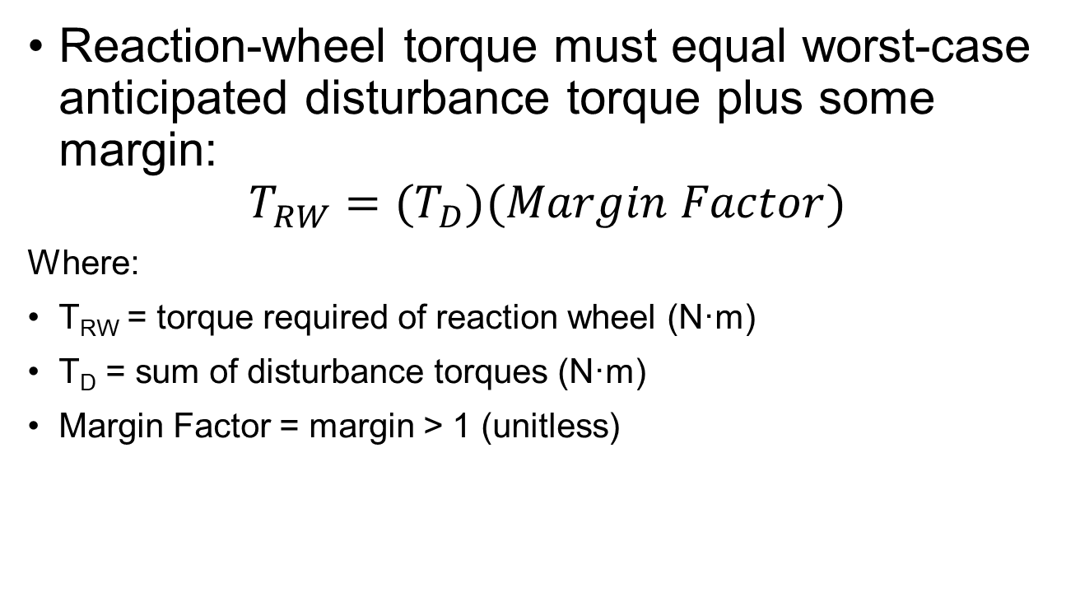
Wheel Sizing (1/3)
Reaction-wheel torque must equal worst-case anticipated disturbance torque plus some margin:
$$T_{RW}=(T_{D})(Margin Factor)$$
Where:
T_{RW} = torque required of reaction wheel (N·m)
T_{D} = sum of disturbance torques (N·m)
Margin Factor = margin > 1 (unitless)

Slide 20
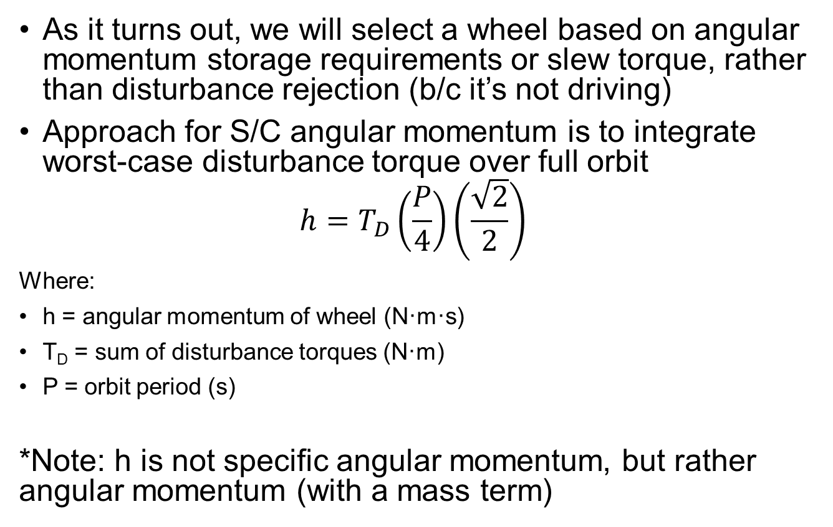
Wheel Sizing (2/3)
As it turns out, we will select a wheel based on angular momentum storage requirements or slew torque, rather than disturbance rejection (b/c it’s not driving)
Approach for S/C angular momentum is to integrate worst-case disturbance torque over full orbit
$$h=T_{D}\left(\frac{P}{4}\right)\left(\frac{\sqrt{2}}{2}\right)$$
Where:
h = angular momentum of wheel (N·m·s)
T_{D} = sum of disturbance torques (N·m)
P = orbit period (s)
*Note: h is not specific angular momentum, but rather angular momentum (with a mass term)

Slide 21
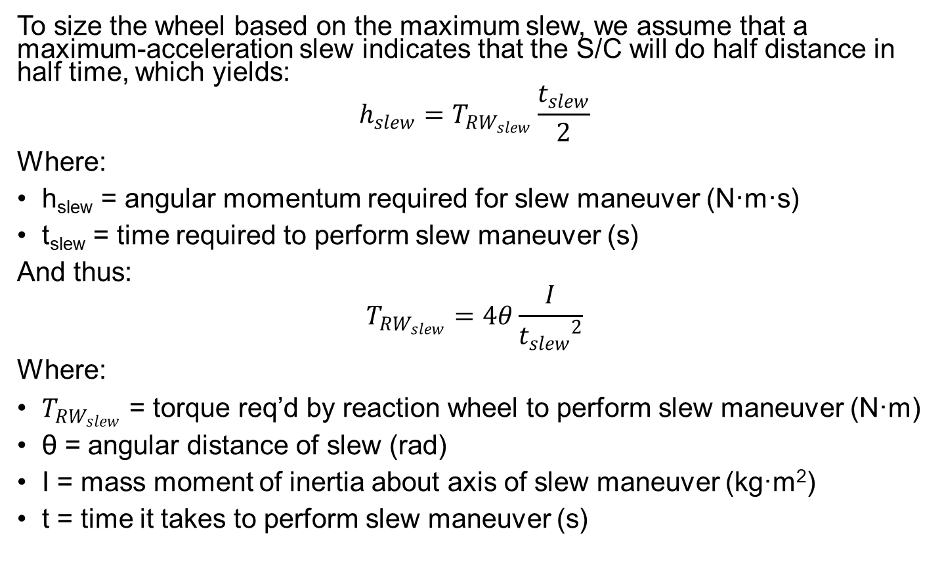
Wheel Sizing (3/3)
To size the wheel based on the maximum slew, we assume that a maximum-acceleration slew indicates that the S/C will do half distance in half time, which yields:
$$h_{slew}=T_{RW_{slew}}\frac{t_{slew}}{2}$$
Where:
h_{slew} = angular momentum required for slew maneuver (N·m·s)
t_{slew} = time required to perform slew maneuver (s)
And thus:
$$T_{{RW}_{slew}}=4θ\frac{I}{{t_{slew}}^{2}}$$
Where:
$T_{{RW}_{slew}}$ = torque req’d by reaction wheel to perform slew maneuver (N·m)
θ = angular distance of slew (rad)
I = mass moment of inertia about axis of slew maneuver (kg·m²)
t = time it takes to perform slew maneuver (s)

Slide 22
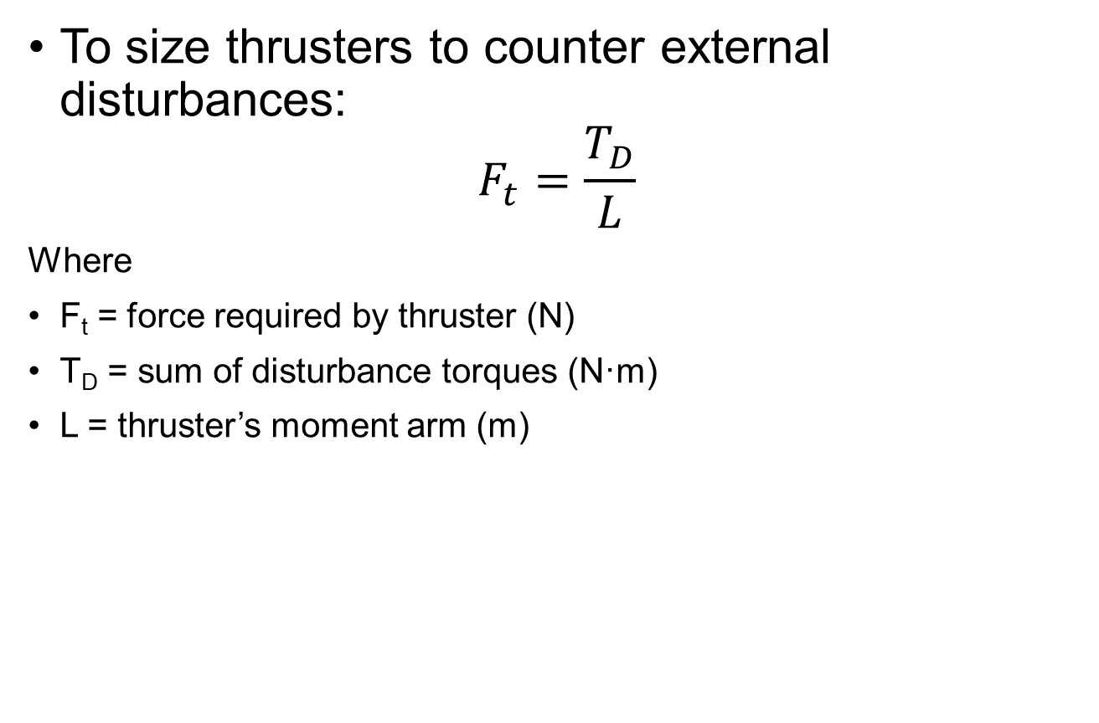
Thruster Sizing (1/3)
To size thrusters to counter external disturbances:
$$F_{t}=\frac{T_{D}}{L}$$
Where
F_{t} = force required by thruster (N)
T_{D} = sum of disturbance torques (N·m)
L = thruster’s moment arm (m)

Slide 23
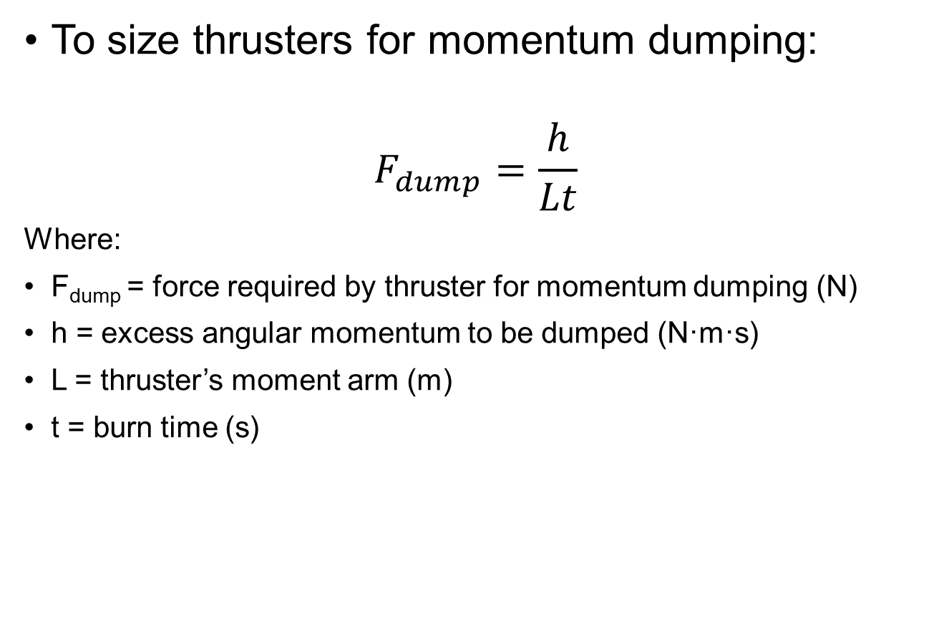
Thruster Sizing (2/3)
To size thrusters for momentum dumping:
$$F_{dump}=\frac{h}{Lt}$$
Where:
F_{dump} = force required by thruster for momentum dumping (N)
h = excess angular momentum to be dumped (N·m·s)
L = thruster’s moment arm (m)
t = burn time (s)

Slide 24
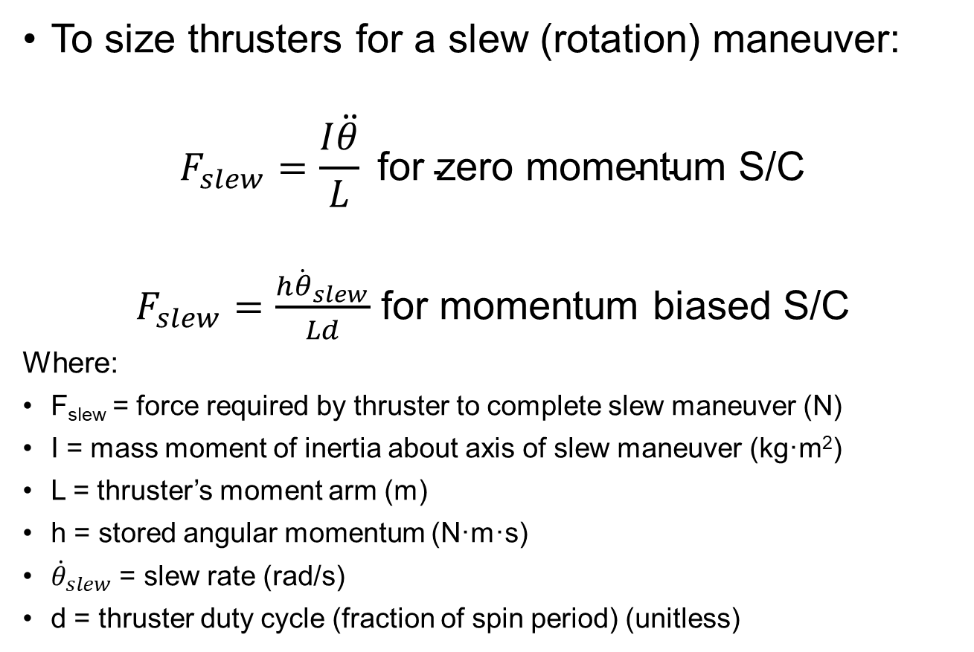
Thruster Sizing (3/3)
To size thrusters for a slew (rotation) maneuver:
$$F_{slew}=\frac{I\ddot{θ}}{L} \text{for} \text{zero} \text{momentum} \text{S}\text{/}\text{C}$$
$F_{slew}=\frac{h{\dot{θ}}_{slew}}{Ld}$ for momentum biased S/C
Where:
F_{slew} = force required by thruster to complete slew maneuver (N)
I = mass moment of inertia about axis of slew maneuver (kg·m²)
L = thruster’s moment arm (m)
h = stored angular momentum (N·m·s)
${\dot{θ}}_{slew}$ = slew rate (rad/s)
d = thruster duty cycle (fraction of spin period) (unitless)

Slide 25
Generic Thruster Slew Maneuver

Slide 26
Example
Given:
S/C mass = 174 kg
I_{x} = I_{z} = 75 kg∙m²
I_{y} = 45 kg∙m²
S/C cross-sectional area, A_{s} = 2 m²
coefficient of drag, C_{d} = 2.5
atmospheric density at 700 km altitude: ρ = 1.47x10⁻¹³ kg/m³
Maximum deviation from nadir-pointing = 30 deg
(c_{pa} – c_{m}) = 0.3 m
(c_{ps} – c_{m}) = 0.3 m
coefficient of reflectivity, q = 0.6
S/C magnetic dipole, D = 1 A∙m²
pointing accuracy required < 0.1 deg
slew maneuver of 30 deg in no more than 10 minutes
Find: Size reaction wheels (find required torque and angular momentum storage)

Slide 27
Solution
Approach: Look at all of the limitations discussed and see which requires the most momentum storage
Torque Capability (N·m)
Disturbance rejection
Slew maneuver
Momentum Storage Capacity (N·m·s)
Disturbance rejection over an orbit
Slew maneuver

Slide 28
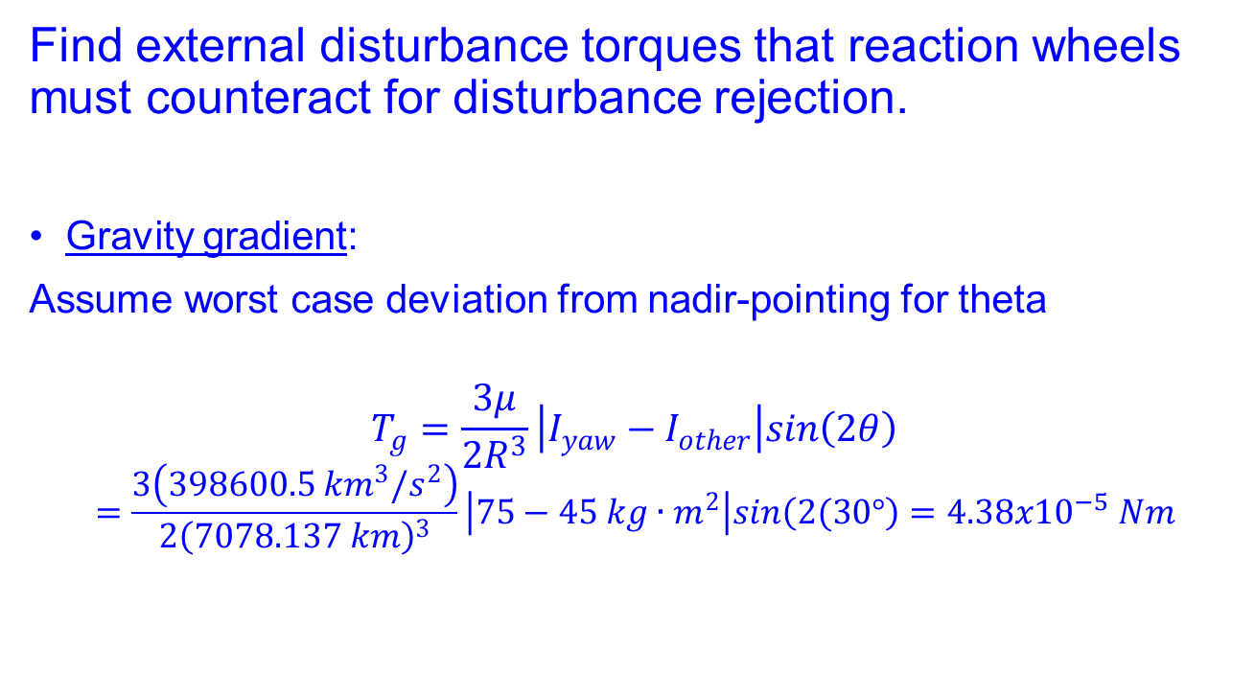
Solution
Find external disturbance torques that reaction wheels must counteract for disturbance rejection.
Gravity gradient:
Assume worst case deviation from nadir-pointing for theta
$$T_{g}=\frac{3μ}{2R^{3}}\left|I_{yaw}−I_{other}\right|sin\left(2θ\right)$$
$$=\frac{3\left(398600.5 {km}^{3}/s^{2}\right)}{2{\left(7078.137 km\right)}^{3}}\left|75−45 kg∙m^{2}\right|sin\left(2(30°\right)=4.38x{10}^{−5} Nm$$

Slide 29
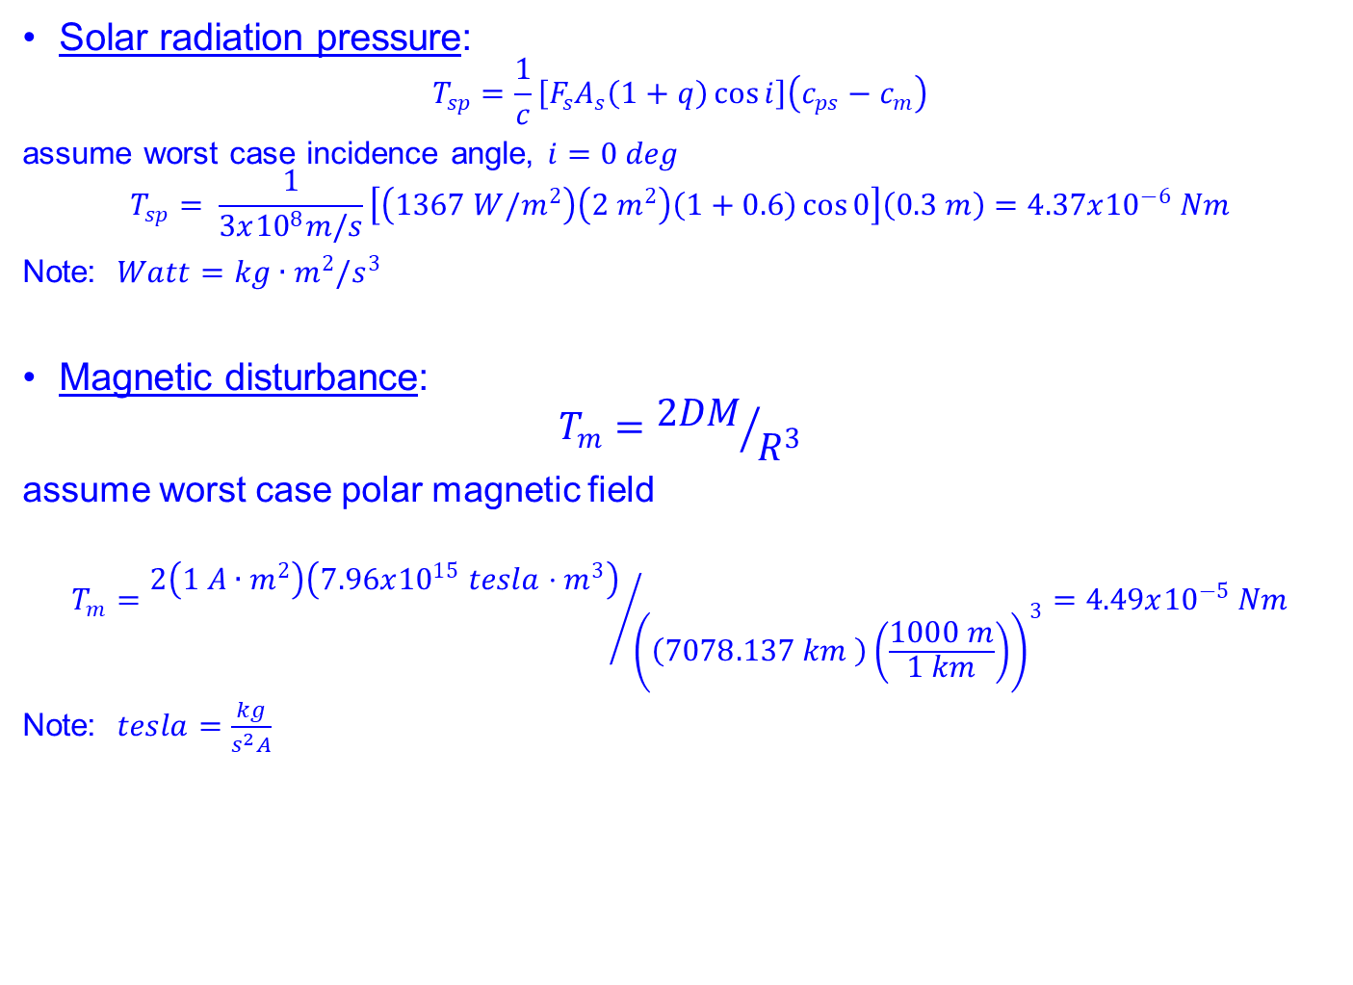
Solution
Solar radiation pressure:
$$T_{sp}=\frac{1}{c}\left[F_{s}A_{s}\left(1+q\right)\cos{i}\right]\left(c_{ps}−c_{m}\right)$$
assume worst case incidence angle, $i=0 deg$
$$T_{sp}= \frac{1}{3x{10}^{8}m/s}\left[\left(1367 W/m^{2}\right)\left(2 m^{2}\right)\left(1+0.6\right)\cos{0}\right]\left(0.3 m\right)=4.37x{10}^{−6} Nm$$
Note: $Watt=kg∙m^{2}/s^{3}$
Magnetic disturbance:
$$T_{m}={2DM}/{R^{3}}$$
assume worst case polar magnetic field
$$T_{m}={2\left(1 A∙m^{2}\right)\left(7.96x{10}^{15} tesla⋅m^{3}\right)}/{{\left(\left(7078.137 km \right)\left(\frac{1000 m}{1 km}\right)\right)}^{3}}=4.49x{10}^{−5} Nm$$
Note: $tesla=\frac{kg}{s^{2}A}$

Slide 30
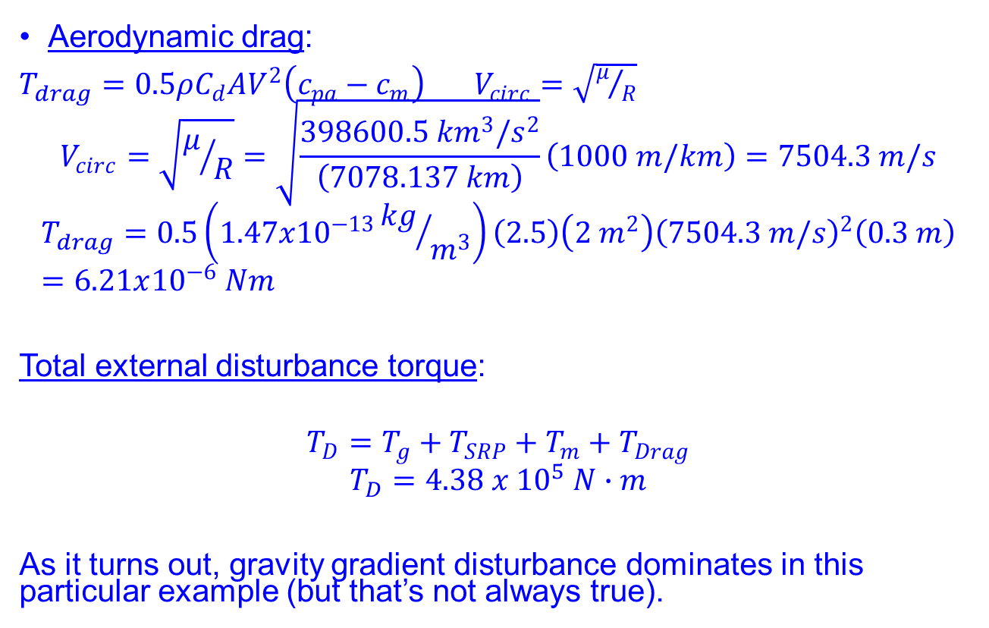
Solution
Aerodynamic drag:
$T_{drag}=0.5ρC_{d}AV^{2}\left(c_{pa}−c_{m}\right)$ $V_{circ}=\sqrt{μ/R}$
$$V_{circ}=\sqrt{μ/R}=\sqrt{\frac{398600.5 {km}^{3}/s^{2}}{\left(7078.137 km\right)}}\left(1000 m/km\right)=7504.3 m/s$$
$$T_{drag}=0.5\left(1.47x{10}^{−13}{kg}/{m^{3}}\right)\left(2.5\right)\left(2 m^{2}\right){\left(7504.3 m/s\right)}^{2}\left(0.3 m\right)=6.21x{10}^{−6} Nm$$
Total external disturbance torque:
$$T_{D}=T_{g}+T_{SRP}+T_{m}+T_{Drag}$$
$$T_{D}=4.38 x {10}^{5} N∙m$$
As it turns out, gravity gradient disturbance dominates in this particular example (but that’s not always true).

Slide 31
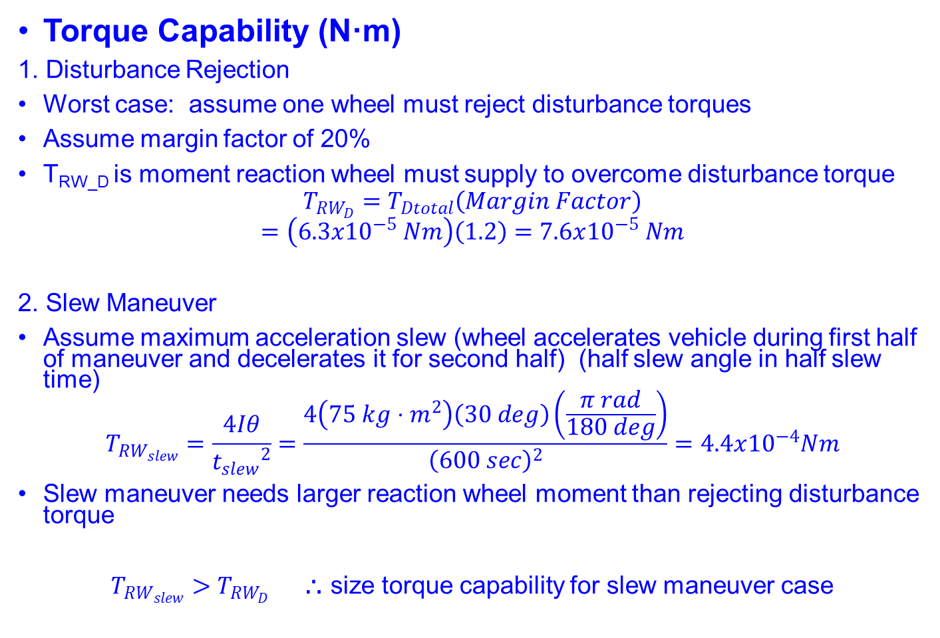
Solution
Torque Capability (N·m)
1. Disturbance Rejection
Worst case: assume one wheel must reject disturbance torques
Assume margin factor of 20%
T_{RW_D} is moment reaction wheel must supply to overcome disturbance torque
$$T_{RW_{D}}=T_{Dtotal}\left(Margin Factor\right)$$
$$=\left(6.3x{10}^{−5} Nm\right)\left(1.2\right)=7.6x{10}^{−5} Nm$$
2. Slew Maneuver
Assume maximum acceleration slew (wheel accelerates vehicle during first half of maneuver and decelerates it for second half) (half slew angle in half slew time)
$$T_{RW_{slew}}=\frac{4Iθ}{{t_{slew}}^{2}}=\frac{4\left(75 kg⋅m^{2}\right)\left(30 deg\right)\left(\frac{π rad}{180 deg}\right)}{{\left(600 sec\right)}^{2}}=4.4x{10}^{−4}Nm$$
Slew maneuver needs larger reaction wheel moment than rejecting disturbance torque
$T_{RW_{slew}}>T_{RW_{D}}$ ⸫ size torque capability for slew maneuver case

Slide 32
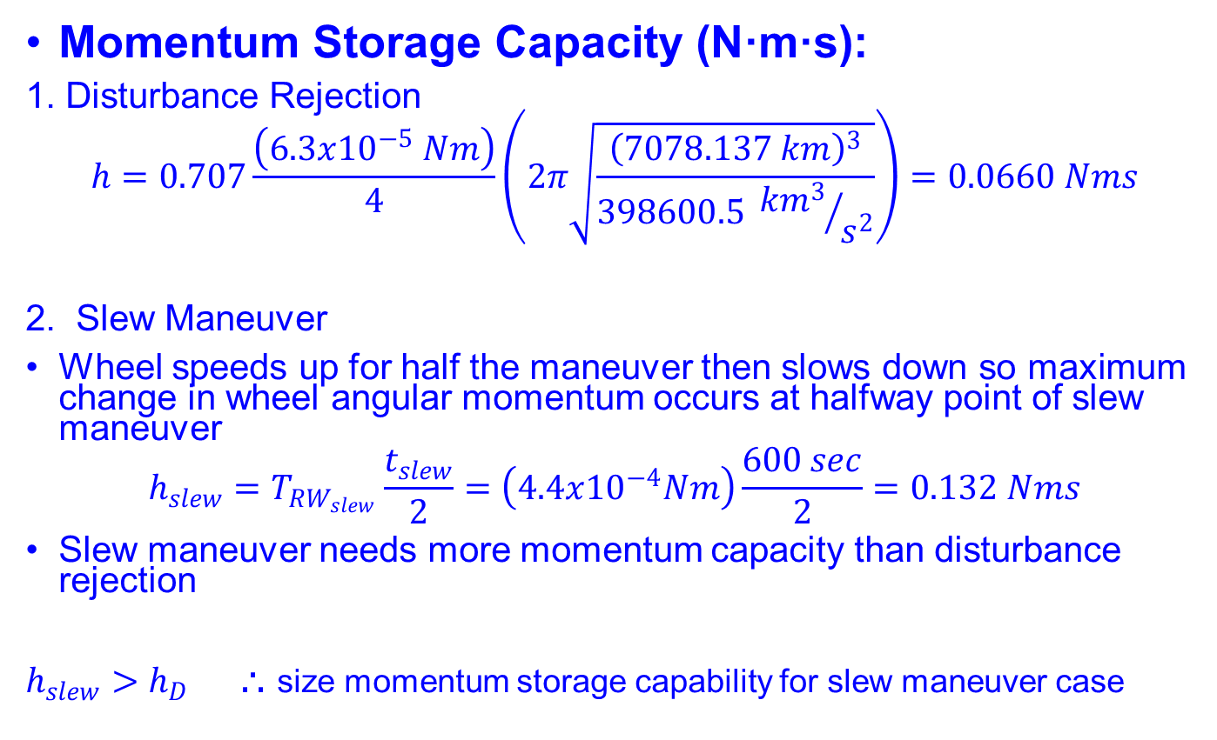
Solution
Momentum Storage Capacity (N·m·s):
1. Disturbance Rejection
$$h=0.707\frac{\left(6.3x{10}^{−5} Nm\right)}{4}\left(2π\sqrt{\frac{{\left(7078.137 km\right)}^{3}}{398600.5 {{km}^{3}}/{s^{2}}}}\right)=0.0660 Nms$$
2. Slew Maneuver
Wheel speeds up for half the maneuver then slows down so maximum change in wheel angular momentum occurs at halfway point of slew maneuver
$$h_{slew}=T_{RW_{slew}}\frac{t_{slew}}{2}=\left(4.4x{10}^{−4}Nm\right)\frac{600 sec}{2}=0.132 Nms$$
Slew maneuver needs more momentum capacity than disturbance rejection
$h_{slew}>h_{D}$ ⸫ size momentum storage capability for slew maneuver case

Slide 33
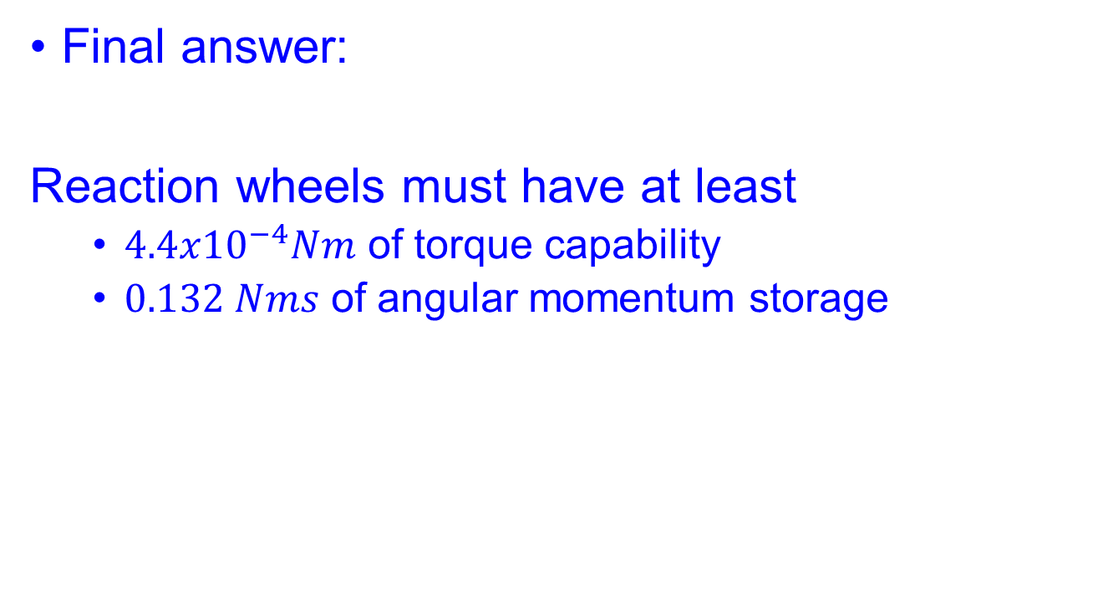
Solution
Final answer:
Reaction wheels must have at least
$4.4x{10}^{−4}Nm$ of torque capability
$0.132 Nms$ of angular momentum storage

